Slide 1
Directorate of Continuing Education (CE)
School of Distance Learning
“Building Communities of Online
Language Learners Worldwide”
Dr. Betty Lou Leaver
Associate Provost
Michael L. Vezilich
Dean

Slide 2
Distance Learning Overview
Today’s Agenda
DL at Continuing Education – Mission Evolution & Vision
DL Programs
Synchronous Instruction: BLTS-DCO
Delivery over Hand-Held Devices
Asynchronous Instruction: Sakai LMS
Live BLTS class observations
Questions and Discussion
Notes:
Another 5+K in MTT ICH
Reaching nearly 1000 students

Slide 3
Continuing Education
Mission
“CE provides culturally based foreign language orientation, acquisition, sustainment, and enhancement through instruction, language services, learner assessment, and technology-mediated programs worldwide for DoD and government personnel to ensure the success of the Defense Language Program and enhance the security of the nation.”

Slide 4
The Virtual DLI Vision
“The preferred one-stop source for DoD language consumers worldwide, providing Distance Learning opportunities to meet emerging needs across DoD, using technology-mediated delivery of products combined with individualized student services to cultivate, foster and empower lifelong language learners.”

Slide 5

Distance Learning Programs
Nineteen in-house languages (Arabic, Chinese, Dari, Farsi, French, German, Hebrew, Hindi, Italian, Korean, Kurdish, Pashto, Portuguese, Russian, Serbian/Croatian, Spanish, Tagalog, Urdu, Vietnamese) and several additional languages on demand (Indonesian, Japanese, Thai, Turkish…) providing technology-mediated initial acquisition and post-basic refresher, sustainment, enhancement, conversion and special focus language training to over 30,000 DoD military and civilian field linguists, language-skilled professionals and the language-enabled general purpose force

Slide 6
Distance Learning Programs
Army concept of distance learning
Flexible deployment of Mobile Training Teams (MTTs) to augment technology-mediated efforts delivering over 20K training hours to 30+ sites with over 1000 students in FY11
Notes:
Another 5+K in MTT ICH
Reaching nearly 1000 students

Slide 7
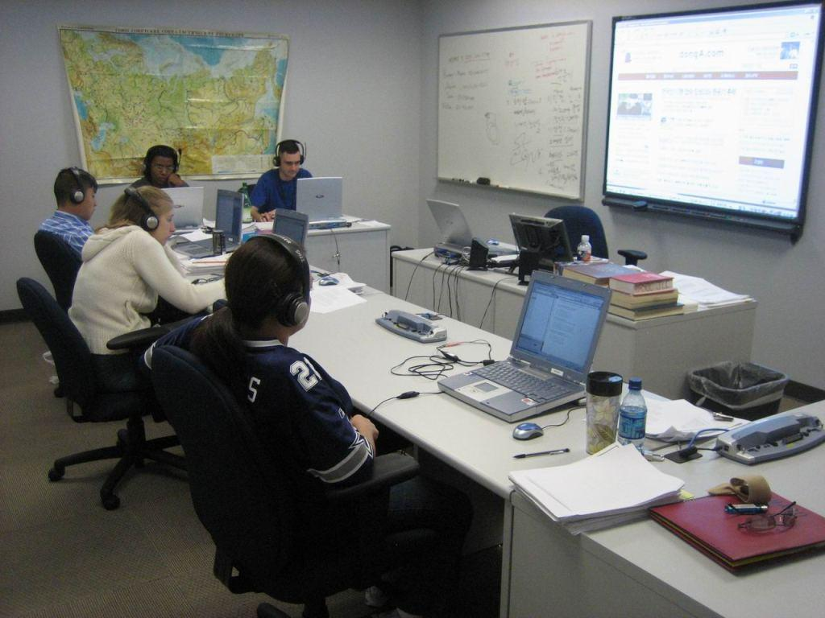
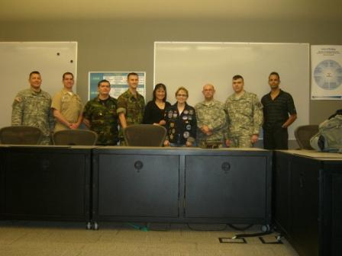
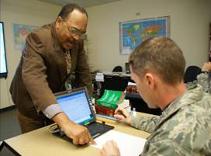
Post-Basic
Mobile Training Teams (MTTs)
  On-demand, high quality instruction delivered in a traditional residential setting.
  In FY11, 117 Post-Basic MTTs in 16 languages were conducted to support the professional linguist community.
  Of those, 4 for the Navy, 30 for the Army, 12 for Marines, 45 for the Air Force and 26 for DoD/Civ Agencies – 19,787 total hours

Slide 8

Locations - MTT Sites (US)
Offutt AFB
300th MI BDE
Ft. McCoy
Nellis AFB
Ft. Carson
Ft. Meade
NPS
DIA
Ft. Riley
DLIFLC
Ft. Bragg
Ft. Irwin
Goodfellow AFB
Camp Lejeune
Ft. Hood
Camp Pendleton
Ft. Gordon
Davis-Monthan AFB
Ft. Gillem
Ft. Huachuca
Hurlburt Field
Elmendorf AFB
Ft. Polk
Schofield Barracks
Lackland AFB
MCBH

Slide 9

Locations:
MTT Sites (Worldwide)
Menwith Hill
Mildenhall
Darmstadt
Wiesbaden
Misawa NIOC
Garmisch
Kabul
Camp Zama
Kadena AFB

Slide 10
Distance Learning Programs
Legacy Video Tele-Training (VTT) technology delivering over 1000 hrs/yr to 350 students in FY11
Broadband Language Training System (BLTS) delivering online instruction linked with the Sakai Learning Management System (SLMS). Conducted 3500 hours in FY11 with over 150 students to locations worldwide via BLTS
Notes:
Another 5+K in MTT ICH
Reaching nearly 1000 students

Slide 11
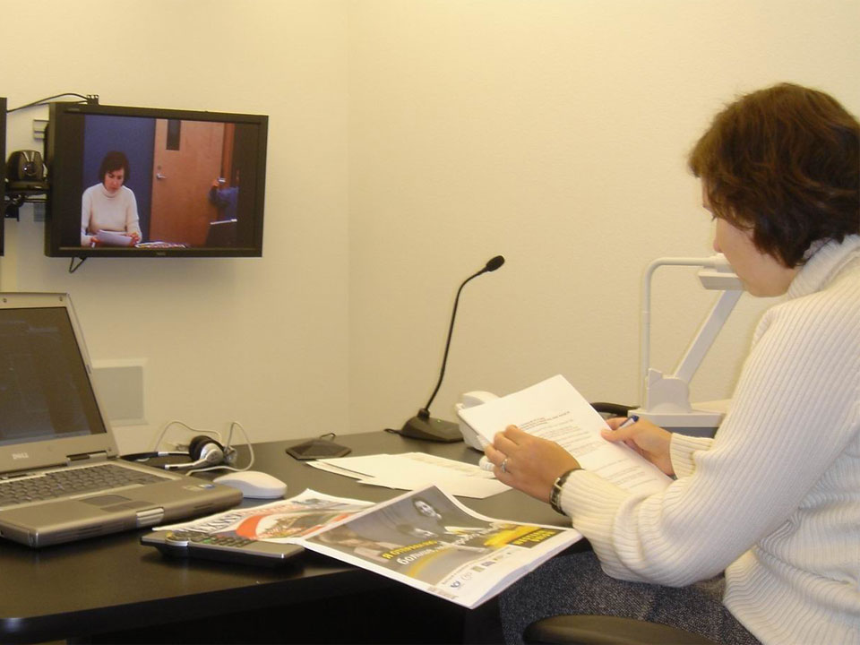
Video Tele-Training (VTT)
Legacy DLIFLC system since late 1980’s; heavily utilized through the 90’s
System upgrade costs, new technologies and limited accessibility to linguists have resulted in decline of usage

Slide 12
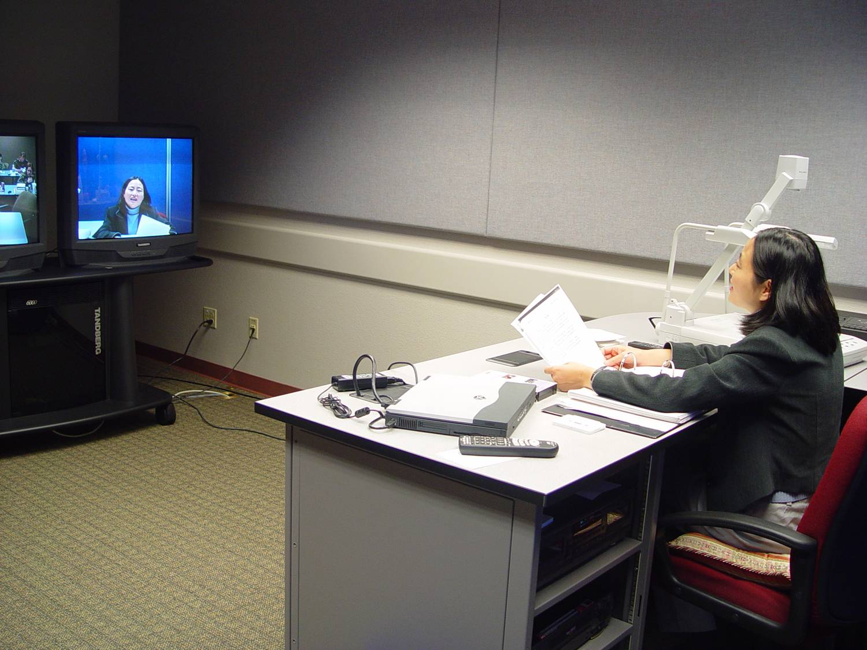
Distance Learning
Technology-mediated Platforms
Video Tele-Training
1,266 hrs in FY11
Twelve Languages in FY11
346 Students in FY11
Headstart / FAM / Post-FAM (var)
Sustainment (< 40 instructional hours)
Refresher (40-80 instructional hours)
Enhancement (80-160 instructional hours)
Special Purpose

Slide 13
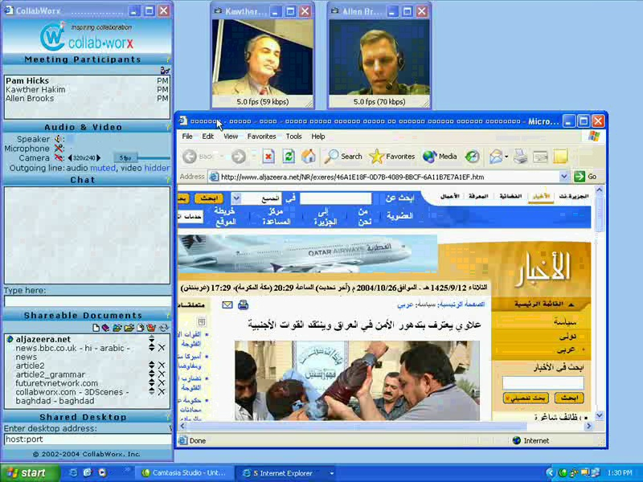
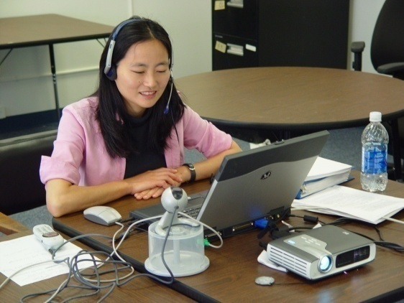
Distance Learning
Technology-mediated Platforms
Video Tele-Training
Broadband Language
Training System (BLTS)
3,473 hrs in FY11
17 Languages in FY11
148 Students in FY11
Exponential growth in FY12
- DLPT Online Readiness Course
PB Sustainment/Enhancement
HeadStart with E-Mentoring
Virtual Diagnostic Assessments
- Includes FAOs in Azerbaijan, Peru, Colombia, Okinawa and Senegal

Slide 14
Broadband Language Training System
GOAL:
To research, develop, test and evaluate a viable, cost-effective distributed learning platform for delivering foreign language training to linguists in isolated areas via broadband technologies achieving
Greater Accessibility

Slide 15
The BLTS Advantage—Greater Accessibility
Reaching linguists not reachable before
Expanding delivery without building studios
Flexible, multiple sites vs. fixed locations
Better class formation and management
Accommodation to work shifts
Ability to work at home
Reduced training costs

Slide 16
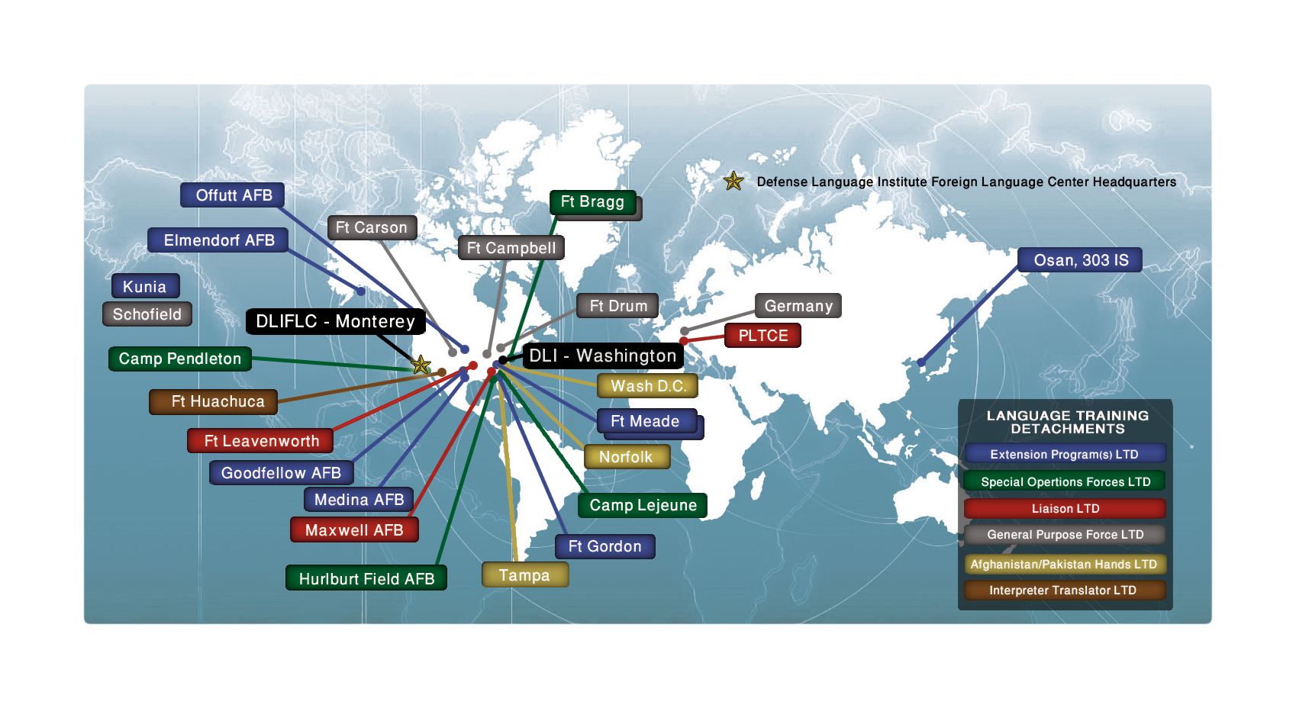
Language Training Detachment Current Status
27 activities/26 locations
Notes:
The Defense Language Institute Foreign Language Center provides foreign language education and training to the Department of Defense at various levels of proficiency and need in Monterey, via Distance Learning platforms, mobile training teams, and through faculty and staff permanently stationed outside of Monterey. Those stationed outside of Monterey are termed Language Training Detachments and range in size from a one person liaison to some detachments consisting of 20 or more faculty and staff. Many of the Language Training Detachments (or LTDs) incorporate contracted faculty. There are two major types of LTDs – the Extension Programs Division which consist of nine LTDs providing sustainment and enhancement foreign language services to US military language professionals supporting primarily intelligence agencies and functions. You can see the locations of those LTDs on the left side of this chart.
There are another 18 LTDs fielded by DLIFLC that are supervised as part of the Field Support Division. These LTDs are divided into five major subcategories: LTDs supporting Special Operations Forces, those supporting General Purpose Forces, AFPAK Hands LTDs, Liaison LTDs, and finally an LTD supporting the US Army’s 09L MOS at Ft. Huachuca.
In this information brief, while I will be happy to cover any questions you may have about any type of LTD, I will concentrate on the General Purpose Force LTDs – their function, their funding, and their future. I will discuss current requirements, requested additional requirements, and any funding deltas.

Slide 17
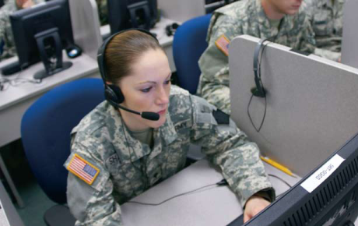
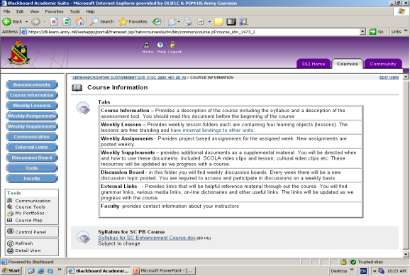


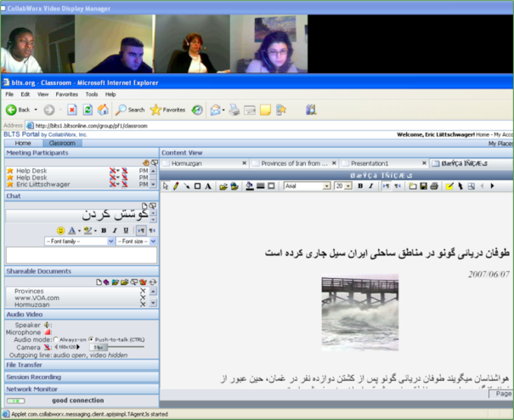
Hybrid Delivery /
Blended Learning
Hybrid delivery / Blended Learning (Online asynchronous self-study with interactive/synchronous VTT or BLTS E-mentoring sessions)

Slide 18
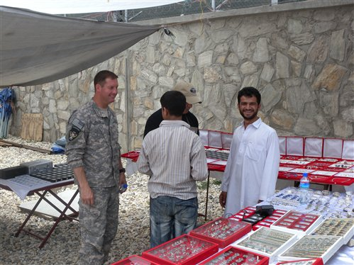

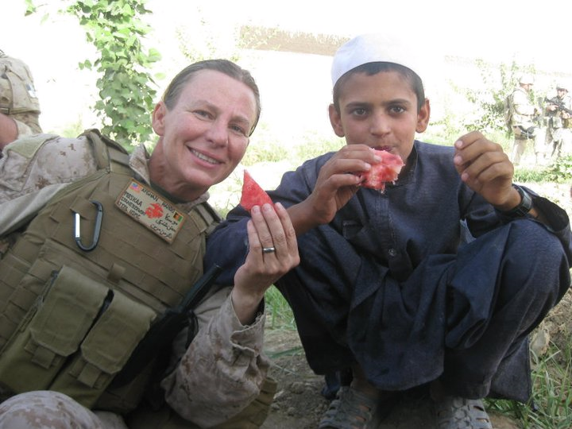
AFPAK Hands Phase I-IV
  Provide language education in Dari, Pashto & Urdu to a cohort of military personnel who will be habitually involved in OEF (initial acquisition, sustainment, and enhancement – achieve at least ILR 2 during a career)
  Hub established in D.C., Norfolk & Tampa
  Phase I: 16 weeks acquisition at a Hub
    356 graduates (249 Dari, 76 Pashto, 31 Urdu)
    80% achieve ILR 1 or better on OPI
    52 currently in class
  Phase II: Self-Study learning modules w/available E-mentoring (24 modules in each language) + In-Theatre Support
  Phase III: Self-Study learning modules enhanced with online and on-site instruction (First iteration: 27 June 11).
  Phase IV: Follow on residential training at a hub location.

Slide 19
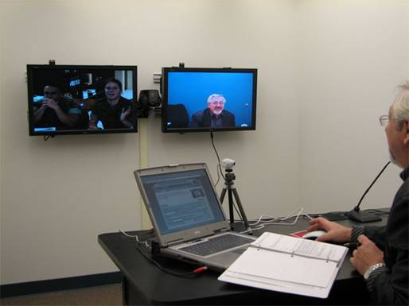

Live BLTS Classroom Observation
Post-Basic Online Sustainment
& Enhancement Course
►
The goal of Post-Basic Sustainment/Enhancement Course is long-term maintenance of proficiency skills at any level of proficiency, and may be repeated indefinitely as it is designed for all levels above Level 2.
This course includes a pre-course and post-course Diagnostic Assessment, and is delivered via BLTS and an LMS.
This course includes 12 weeks of synchronous and asynchronous study: (4-6 hours of self-study and 4-6 hours in an on-line classroom with an E-Instructor each week).
All four skills are emphasized: reading, writing, listening, speaking.
The course is tailored for the specific needs of participating learners arranged in cohorts of between 2-4 students.
Currently available in nineteen in-house languages. Other languages may be arranged, upon request.
►
►
►
►
►

Slide 20
DL Statistics 2006-2011
 | 2006 | 2007 | 2008 | 2009 | 2010 | 2011
TOTAL HRS | 12,425 | 18,864 | 14,399 | 30,915 | 20,932 | 24,526
MTT HRS | 9,676 | 11,785 | 13,184 | 25,931 | 16,884 | 19,787
VTT HRS | 2,749 | 4,671 | 1,046 | 2,681 | 1,633 | 1,184
BLTS HRS | NA | 2,408 | 169 | 2,303 | 2,415 | 3,473
LANGS | 12 | 12 | 13 | 18 | 26 | 22
CLASSES | 173 | 164 | 212 | 290 | 316 | 277
STUDENTS | 764 | 955 | 1,073 | 1,119 | 1,100 | 1,184

Slide 21
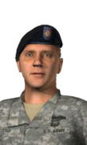
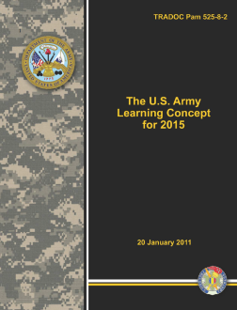
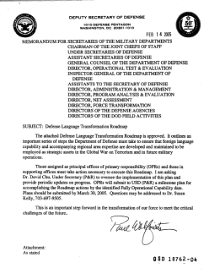
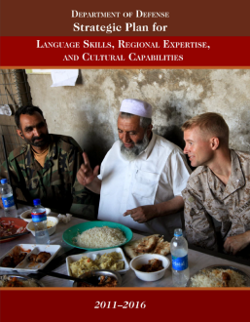
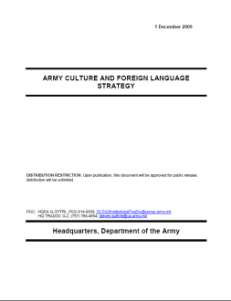
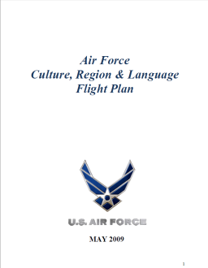
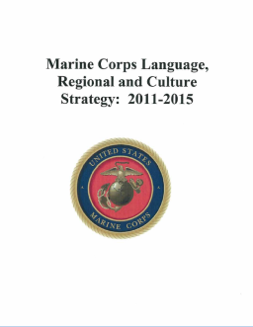
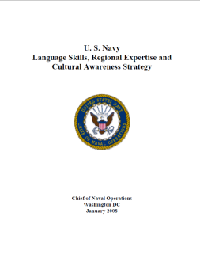
Life-Long Language Learning
Core Principles
▼
Cultivate lifelong language learners irrespective of originating source or proficiency.
▼
Become the preferred “one-stop-shop” to satisfy foreign language learner instructional and support needs.
▼
Provide broadened opportunities for proficiency growth…as far as one’s commitment will take them.
▼
Increase motivation by fostering mutually-supportive “communities of practice” among learners
▼
Develop “personalized” support relationships that evolve throughout the learner’s career.
▼
Rapidly and efficiently deliver adaptable, convenient and scalable content.
Language
Professional
Language
Capable
Language Familiarized

Slide 22






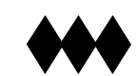
Empowering the
“Life-Long Learner”
DLPT5
Online Refresher Course
Resident
Online
ROTC/Serv Academy
Language Program
Enhancement via
Summer DL
Hybrid
Pre-Deployment
Lang. Familiarization
via Headstart & MTT
Resident
Intermediate Course
Resident
Basic Course
Deployment
Deployment
Attaché Duty
PROMES
DL Language
Sustain/Enhancement
w/E-Mentor
Post-Familiarization
Language Enhancement
w/Language Gateway
(Headstart Phase II)
Joint FAO
Skills Sustainment
Program
DL Language
Sustain/Enhancement
w/E-Mentor
DL Language
Special Purposes
w/E-Mentor

Slide 23
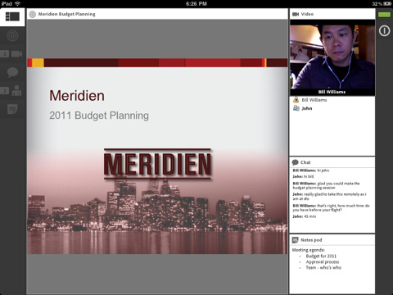
Reaching students in the next generation
Smart Phones & Hand-held Devices
Adobe Connect Mobile 1.5 is now available for free download.
The app supports:
iPhone 3GS with iOS 4 or higher*
iPhone 4 with iOS 4 or higher*
iPod Touch 3rd generation with iOS 4 or higher*
iPad and iPad 2 with iOS 4 or higher*
DL’s Plans for FY12 & Beyond – Stay tuned!

Slide 24
LOGIN AS “GUEST” input your name
VIRTUAL MEETING ROOM
https://connect.dco.dod.mil/cm40

Slide 25
Directorate of Continuing Education (CE)
QUESTIONS AND DISCUSSION

